Slide 1

‘[Desired State Configuration]Basics’
Danny den Braver | OSC

Slide 2






Danny den Braver
@DdBraver
http://www.denbraver.com
http://github.com/DdenBraver
http://nl.linkedin.com/in/ddbraver
Consultant

Slide 3

Agenda:
Wat is Desired State Configuration?
Where can you use DSC?
What do we need?
How does it work?
Demo’s
Resources, resources and more resources…
Questions?

Slide 4
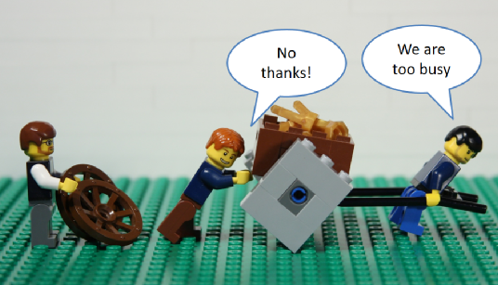
Wat is Desired State Configuration?
And why you should already be using it!
DSC is a new management platform in Windows PowerShell that enables deploying and managing configuration data for software services and managing the environment in which these services run.
--Advantages--
# PowerShell based
# Designed for continuous deployments!
# Seperates configuration from implementation
# Can be used on-prem and in the cloud (Azure DSC)
# Works on Linux! (using OMI Standards)
# Stops configuration drifts

Slide 5
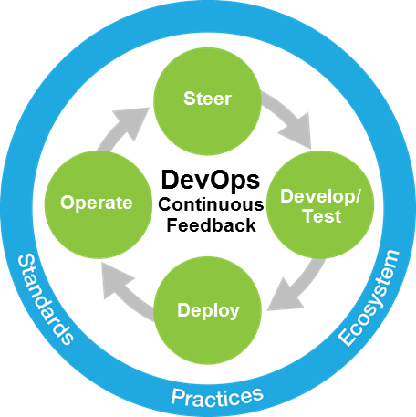
When can you use DSC?
# Enable & disable Roles & Features
# Start & Stop Processes
# Start & Stop Services
# Managing system registry settings
# Managing environment variables
# Manage groups and accounts
# Manage files and directories
# Running powershell scripts
# Deploying software
# Fix drifted configurations
# Monitor configuration status

Slide 6
What do we need?
Prerequisites
# Windows Management Framework 4.0 or later (WMF5 recommended!)
# .Net Framework 4.5
# Windows Server 2008R2 SP1 or later
# Windows 7 SP1 or later
Requirements
# KB2883200 on Windows 8.1 and Server 2012R2
# Powershell remoting should be enabled

Slide 7
How does it work?
DSC Architecture (Push/Pull)
Configuraties are deployed to the servers
Use Start-DSCConfiguration –computername to deploy
DSC Push
Servers contact one or more central servers
Uses SMB or HTTP(S)
DSC Pull

Slide 8
How does it work?
DSC Architecture (Phases)
Specify the configuration trough Powershell
Create the blueprint for the Managed Object File (MOF)
1. Authoring Phase
Push Model:
Generate the MOF file
Push the MOF file(s) to the server
Pull Model:
Generate the MOF Files
Make the MOF files ready for use
Make sure the Modules are in place for download
Push the Meta.Mof to the Server
2. Staging Phase

Slide 9
How does it work?
DSC Architecture (Phases)
Push Model:
Parses the MOF files (Server configuration)
Configures the server using the Imperative Providers
Target servers must have the Imperative Providers Installed
Pull Model
Parses the META.MOF file (Agent configuration)
Downloads the Mof file from the pull server
Parses the MOF file (Server configuration)
Downloads the Imperative Providers (if not available)
Configures the server using the Imperative Providers
3. “Make it so” Phase

Slide 10
1. Authoring Phase
2. Staging Phase
3. “Make it So” Phase
Powershell
Push Model Configuration Staging Area
(Contains DSC Data
Local Configuration Store
3rd Party languages / tools
Parser and Dispatcher
Powershell
Pull Model Server
(Contains DSC Data & Modules)
Imperative Providers
3rd Party languages / tools

Slide 11
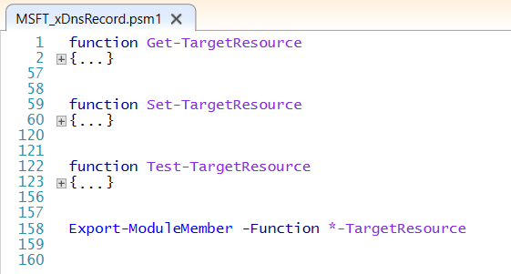
How does it work?
Imperative Providers (DSC Resources)
# Get: Returns a Powershell hash table with the current
status of a server
# Set: Will change the computer according to the DSC
Configuration (only runs when Test returns $false)
# Test: Returns a Boolean (true/false) if a server is compliant

Slide 12
DEMO

Slide 13
Resources, resources and more resources…
Grab your resources from:
https://www.powershellgallery.com/packages?q=Tags%3A%22DSC%22&x=0&y=0
Powershell Gallery using nuget: Find-Module -Repository psgallery -name x* | Install-Module
https://github.com/PowerShell
Create your own resources!
https://msdn.microsoft.com/en-us/powershell/dsc/authoringresource
DSC for Linux
https://blogs.msdn.microsoft.com/powershell/2015/05/05/powershell-dsc-for-linux-is-now-available/
The possibilities are endless….

Slide 14
Questions?

Slide 15
Danny den Braver
@DdBraver
http://www.denbraver.com
http://github.com/DdenBraver
http://nl.linkedin.com/in/ddbraver
Consultant

